Slide 1
Dungeon Game
Art Bible
Part 1 – Organise & Plan the Project With Your Team

Slide 2
Team Organisation
Part 1: Task 1

Slide 3
Team Members & Roles
Determine the roles and duties you and your teammates will perform while working on the project.
Johnny - Programmer
Aiden - Programmer
Georgia - Artist
Eddy - Artist
Part 1: Task 1

Slide 4
Team Protocol for the Project
Write down the protocol you and your team will be using to organise, design and produce this project.
A protocol is an official procedure or system of rules that you will be using to hold yourself and your team members accountable to during the project.
- We will use Trello to ensure tasks are completed by a certain date.
Part 1: Task 1

Slide 5
Communication Tools & Software
Describe the communication tool/software you and your team will be using to organise, plan and manage tasks throughout the project. Describe their functions and how they’ll aid in team collaboration.
You will need to provide one communication tool/software, one task management tool/software and one version control/storage system tool/software.
Tool/Software Name | How your team will use it
Communication Tool | Discord
Version Control/File Storage | USB + Google Drive
Task Management | Trello
Part 1: Task 1

Slide 6
Team Communication
Establish a routine for keeping all members of the team in regular contact to ensure the established schedule is being abided by.
Discord group chat
Have a Trello to do list, and try to finish one model a week per person
Part 1: Task 1

Slide 7
Pre-Production
Part 1: Task 2

Slide 8
Game Description
Player is a miserable office worker who has no family, one day loses everything when his office is raided by kidney stealing gremlins. He goes into the sewers to get revenge and figure out who is behind the raids.
The main dungeon is a sprawling sewers littered with goblin-like creatures, and the boss at the end is actually his old boss. (a dude or skeleton in a tattered suit, dirty and covered in moss and fungi)
Part 1: Task 2

Slide 9
Software Used in the Project
Unity
Maya
Substance Painter
Part 1: Task 2

Slide 10
Timeline of the project.
Milestone | Weeks to complete:
Pre-Production | Week 12
Alpha | Week 14
Beta | Week 16
Gold | Week 17
Submit | Week 18
Part 1: Task 2

Slide 11
Environment
Part 1: Task 2

Slide 12
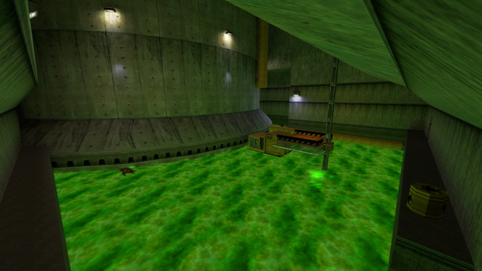
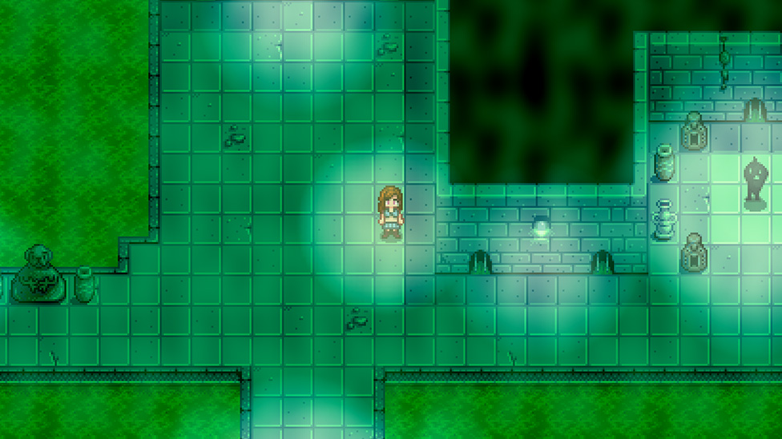
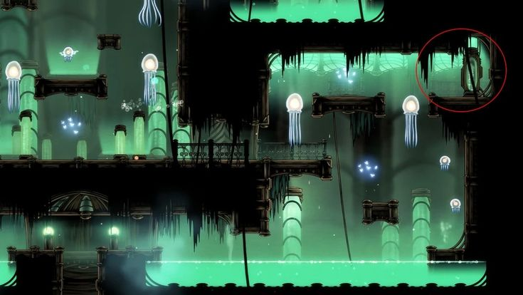
Art Style References & Notes
The artstyle for the dungeon crawler is gloomy, rundown with radioactive waste flowing through the tunnels/corridors. Map is mainly composed of long, narrow tunnels with small rooms connected.
Part 1: Task 2

Slide 13
Asset List - Models
Asset Name | Hours to complete:
Sewer Pipe
Valve (for keys)
Rusty Coin
Sewer gremlin (evil)
Part 1: Task 2

Slide 14
Asset List - Effects
Asset Name | Hours to complete:
Part 1: Task 2

Slide 15
File Formats
Asset Type | File Format
(eg: Models)
(eg: Textures)
Part 1: Task 2

Slide 16
Naming Conventions
Asset Type | Naming Convention
Part 1: Task 2

Slide 17
Top down sketches of the dungeon map
Part 1: Task 2

Slide 18
Color Pallet
Describe the color pallet you will be using for your models.
Put images of colors here or use coolors.co for inspo.
Part 1: Task 2

Slide 19
Concept Art
Put some sketches of your assets here and make sure they are colored in.
Part 1: Task 2

Slide 20
Production
Part 2 – Begin Project Work on the Dungeon

Slide 21
Greybox Screenshots
Create a greybox of your level and take a screenshot from a nice angle.
These models will require the use of prefabs, collision & basic materials (with a base color attached).
Save the scene/level as a separate file and name it ‘DungeonLevel_Greybox’.
At this stage, you should implement the first-person character controller and be able to walk around your scene. This will be your ‘Alpha’ milestone.
Part 2: Task 1

Slide 22
Refined Assets
Part 2: Task 2

Slide 23
Refined Assets Screenshots
Insert Screenshots of refined assets.
Part 2: Task 2

Slide 24
Animation: Pass 1
Insert Screenshots of the required models animating in their ‘pass 1’ stage along with any feedback from the trainer on how to improve them.
Part 2: Task 2

Slide 25
Particle Effects & Lighting
Insert Screenshots of particle effects & lighting
Part 2: Task 3

Slide 26
Additional Effects
Insert Screenshots/Recordings of:
Post-Processing effects: x2
Audio / Sound effects x2
Nice Screenshots of your game area.
Part 2: Task 3

Slide 27
Peer Review
Part 3 – Prepare for Gold Milestone

Slide 28
Bugs/Issues.
Note any bugs/issues with your level here.
Part 3: Task 1

Slide 29
Feedback: Peer #1
Part 3: Task 2

Slide 30
Feedback: Peer #2
Part 3: Task 2

Slide 31
Changelog:
Part 3: Task 3

Slide 32
Feedback: Trainer
Part 3: Task 3

Slide 33
Post-Mortem
Part 4 – Post-Mortem & Submit

Slide 34
Project Review
Write a wholistic and personal review of the project from your perspective.
What did you like about it?
What would you want to change about it? (If anything)
How can you improve this project next time?
Part 4: Task 1

Slide 35
Teamwork Review
Describe a few things that went wrong in the project in each of these areas.
Category | Ways you can Improve | Ways your team could improve
Communication
Version Control/File Storage
Task Management
Part 4: Task 1

Slide 36
Future Improvements
Write down a few ways you and your team could have improved in the following categories:
Category | Ways you can Improve | Ways your team could improve
Communication
Version Control/File Storage
Task Management

Slide 37
Gather all Files
Part 4: Task 2

